Slide 1

JOURNEY TO FOREVER
Honeymoon Destination Analysis

Slide 2
INTRODUCTION
Honeymoons are more than just trips; it is the first stage of a lifetime journey and the beginning to the many stories the couple will tell one another.
The search for the ideal honeymoon location is a special journey filled with hopes, dreams, and an anticipation of shared experiences that will strengthen relationships between partners.
The task of choosing a place that connects with a couple’s common heartbeat becomes difficult and, at times, stressful in a world, where there are a vast number of them, each offering its own unique personality. Therefore, it is of the highest priority to make a wise decision.

Slide 3

BUSSINESS IDEA
Simplify Research
Quick Decision-Making
User-Friendly Interface
Partner-Centric Approach

Slide 4

TARGET AUDIENCE
Couples Planning a Romantic Journey
Wedding Planners and Travel Agents
Tourism Boards and Destination Marketers
Travel Bloggers and Content Creators
Market Researchers and Analysts

Slide 5
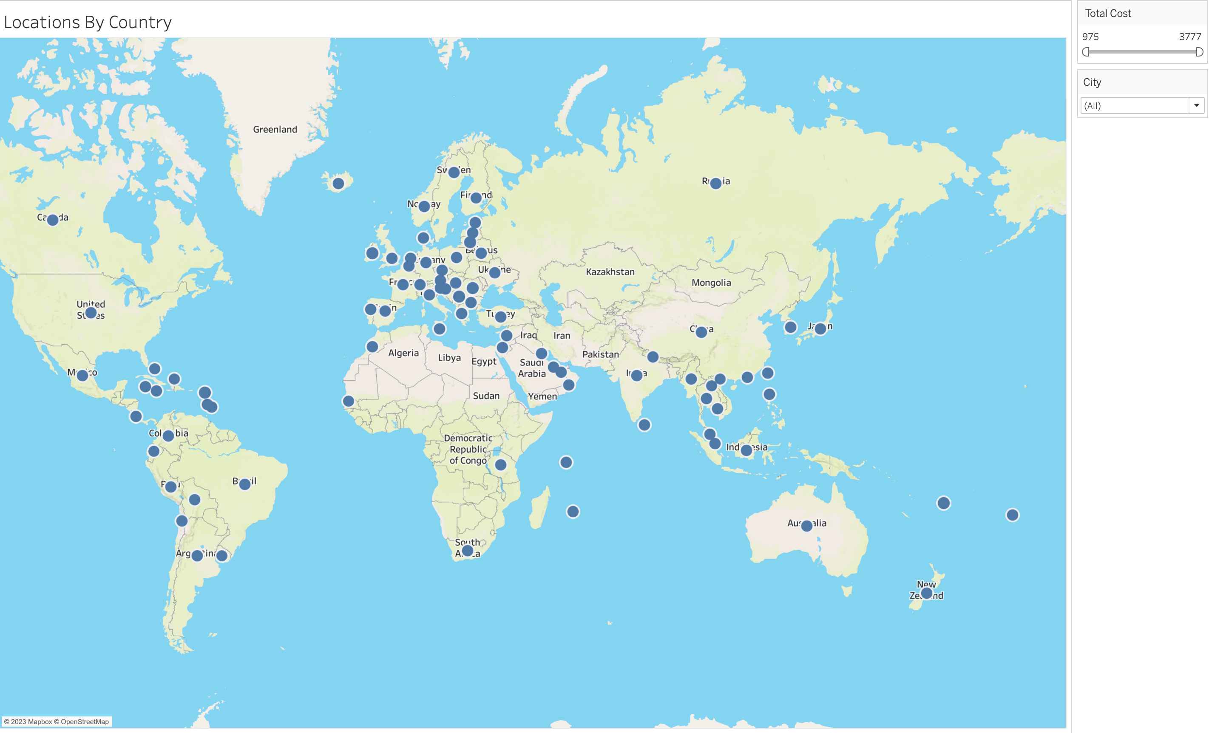
Interactive Honeymoon Map

Slide 6
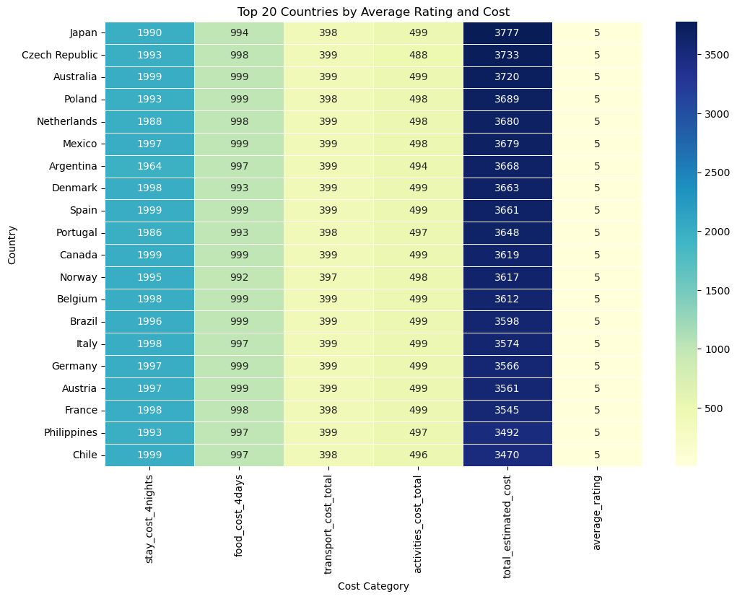
HIGH BUDGET COUNTRIES

Slide 7
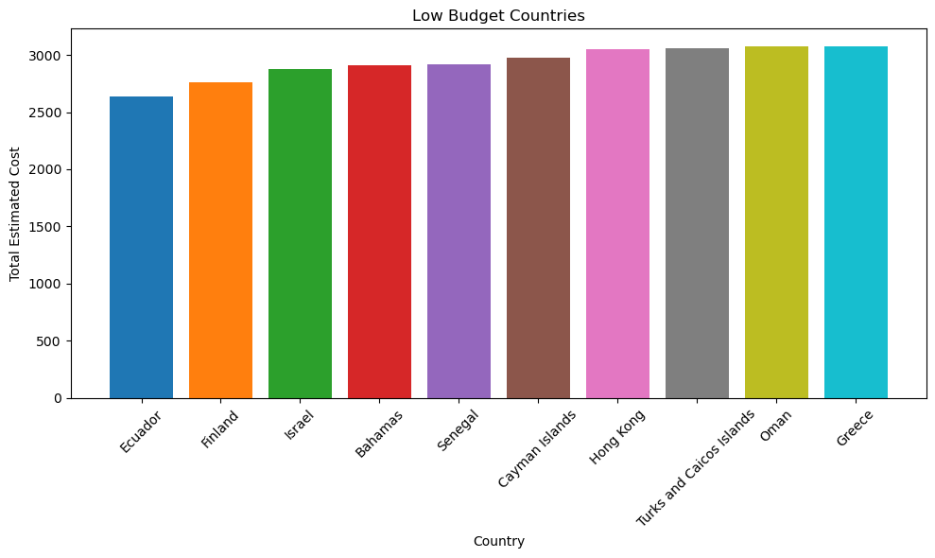
LOW BUDGET COUNTRIES

Slide 8
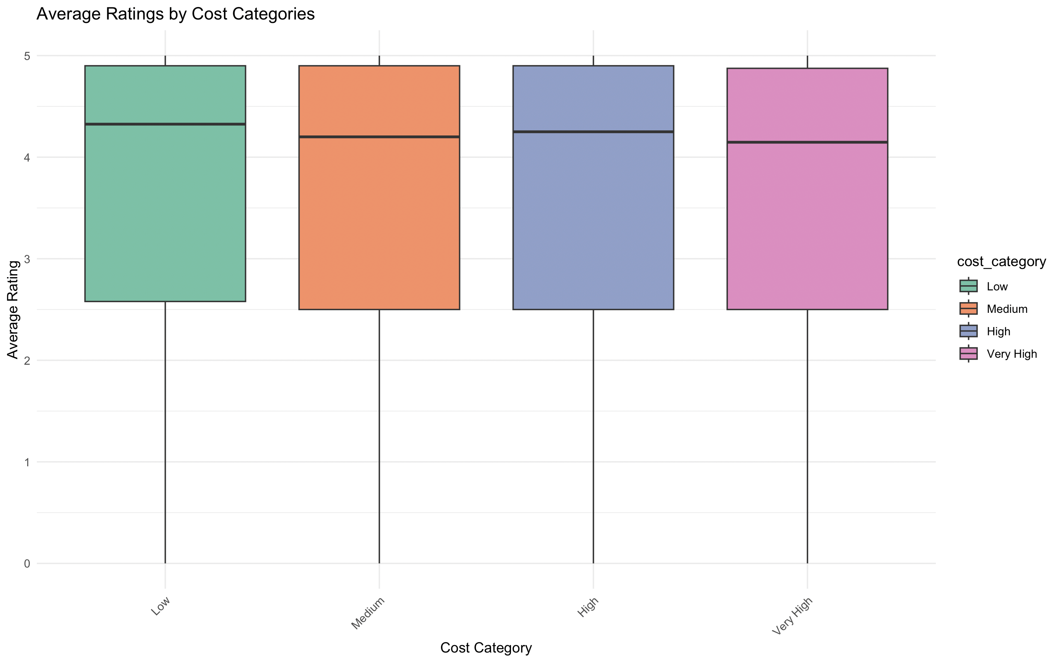
Cost Vs Quality Relationships

Slide 9
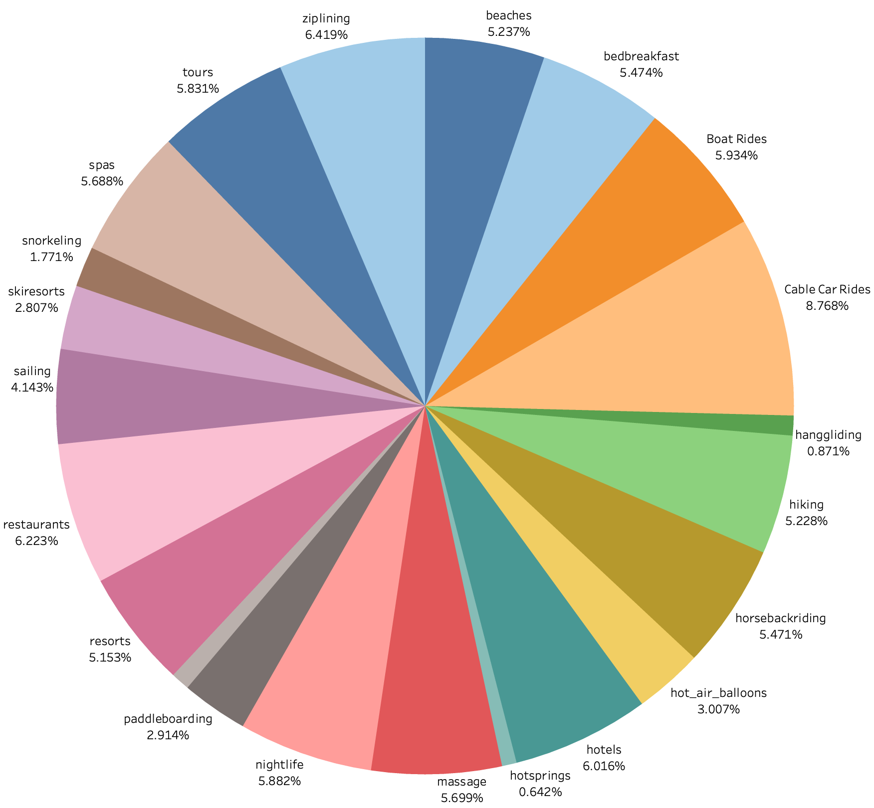
Proportion Of Activities

Slide 10
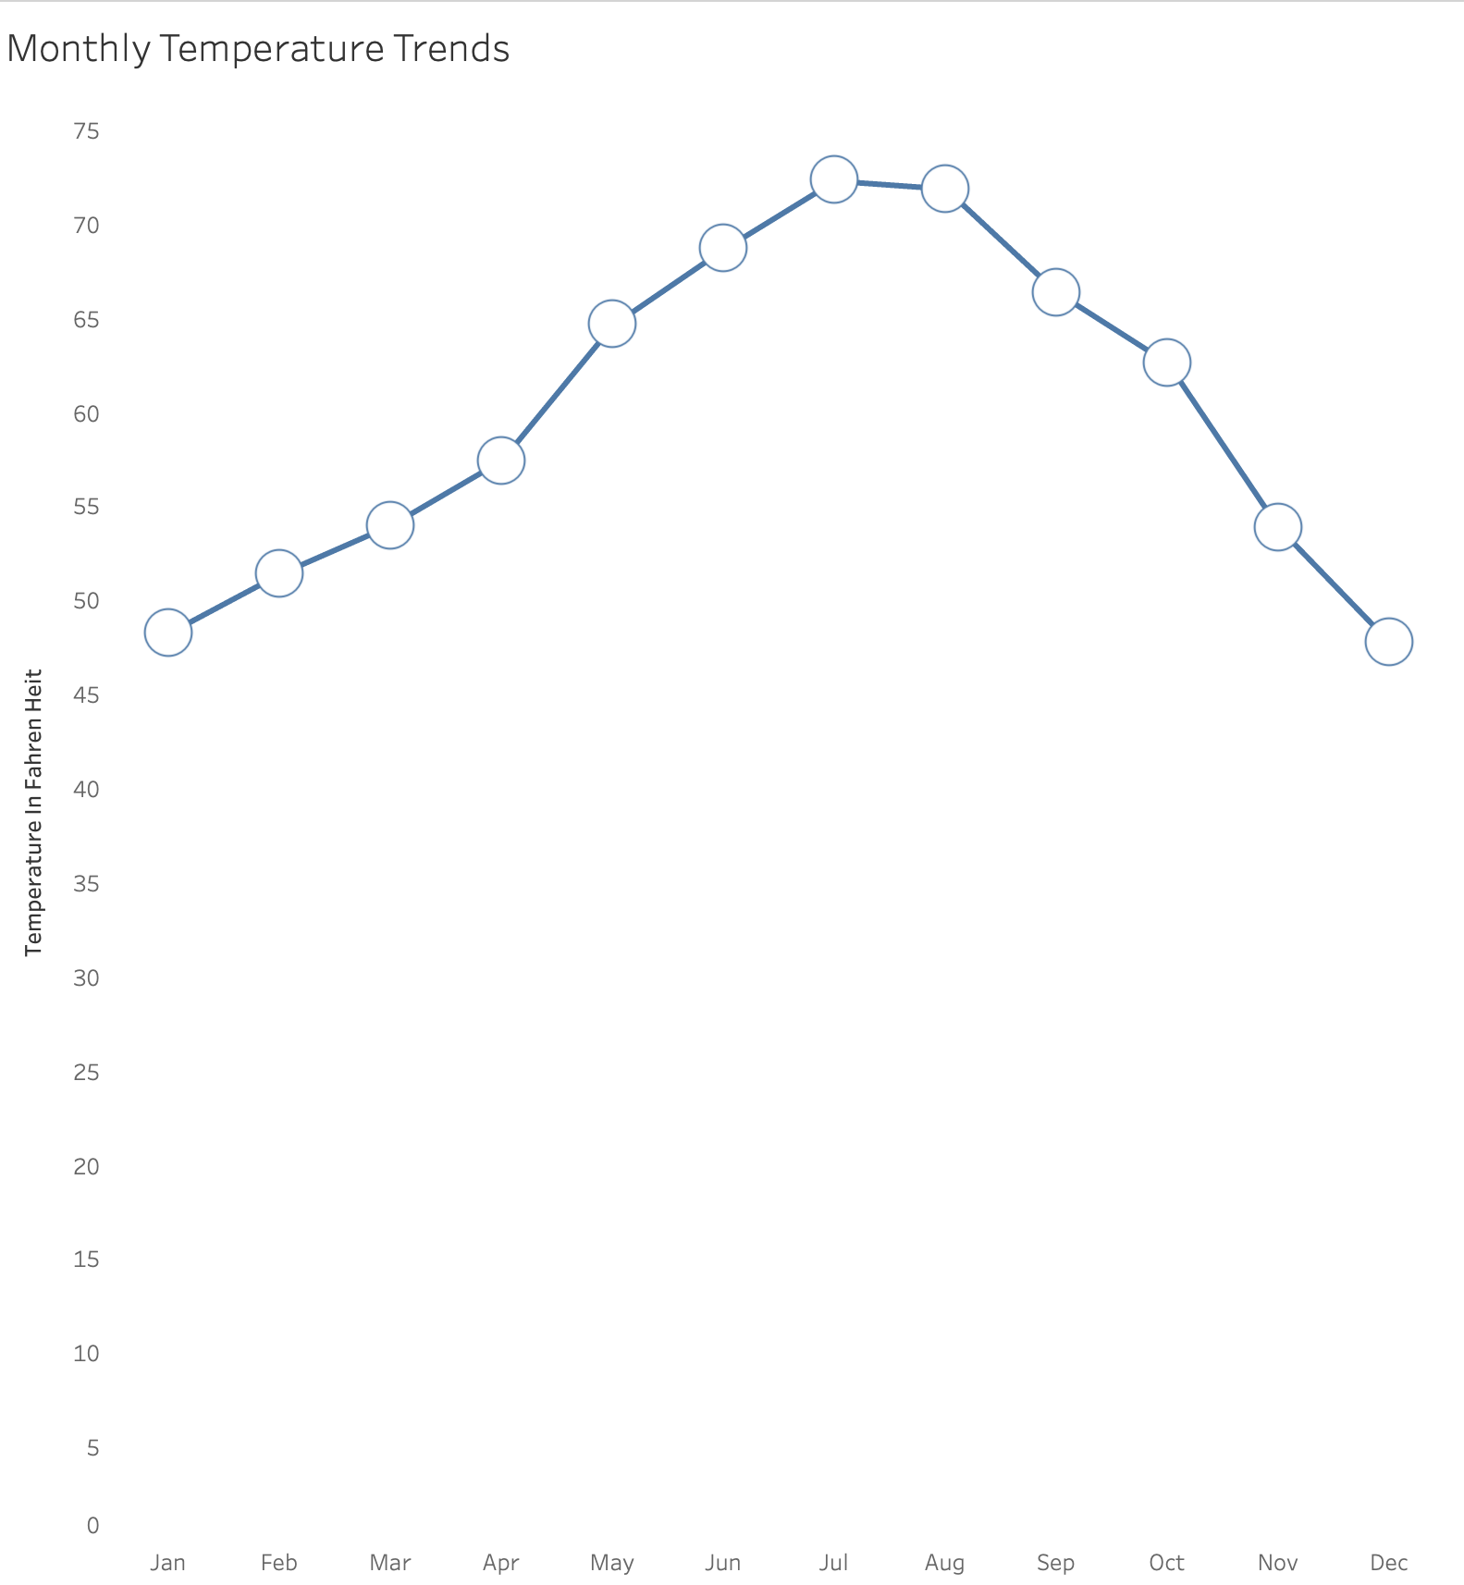
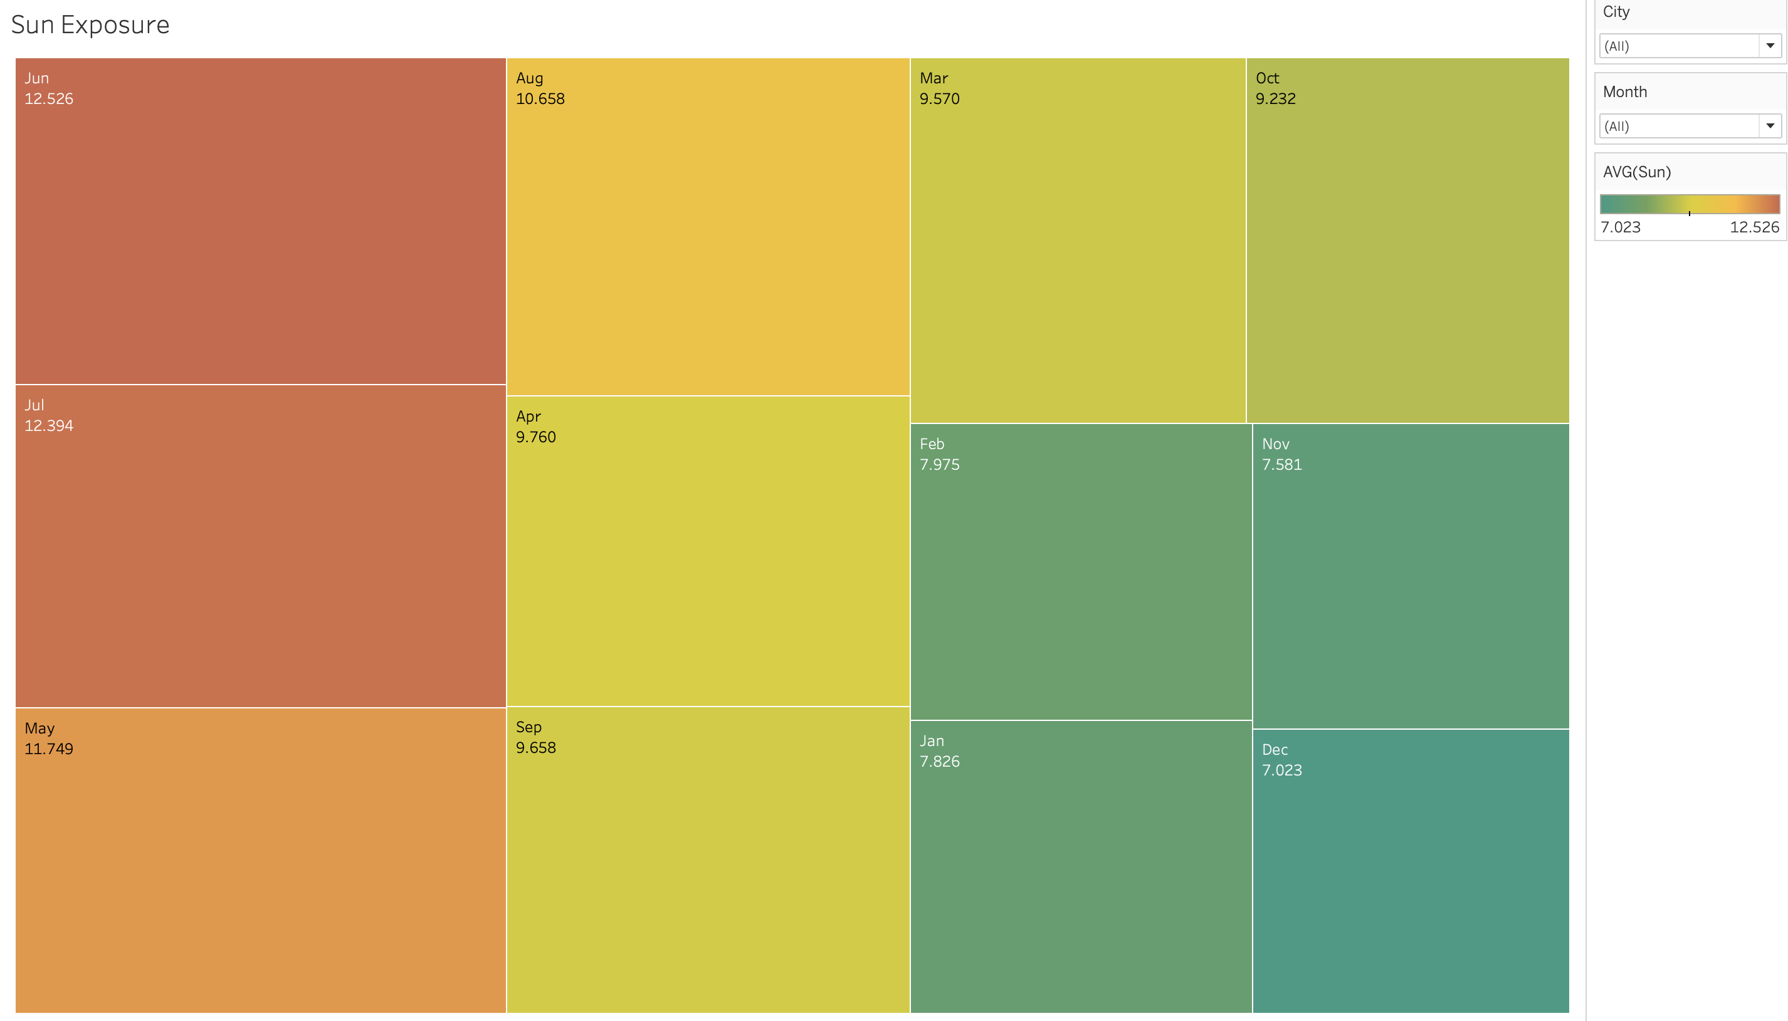
Monthly Climatic Trends

Slide 11
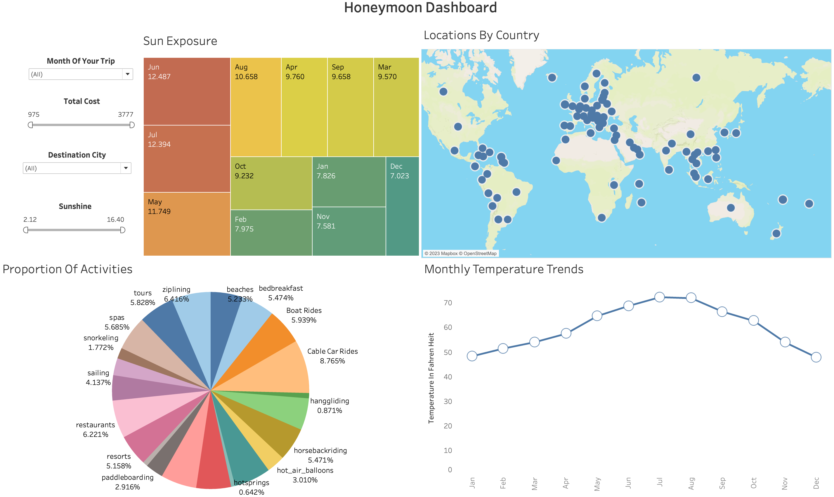
Dashboard

Slide 12

CONCLUSION?

Slide 13

BY CHARITHA

